Slide 1
Team 4
Eric Arnold, Matt Chandler,
Tara McKaskle, and Sean Roberts
PCIS
(Printer Cartridge Inventory System)

Slide 2
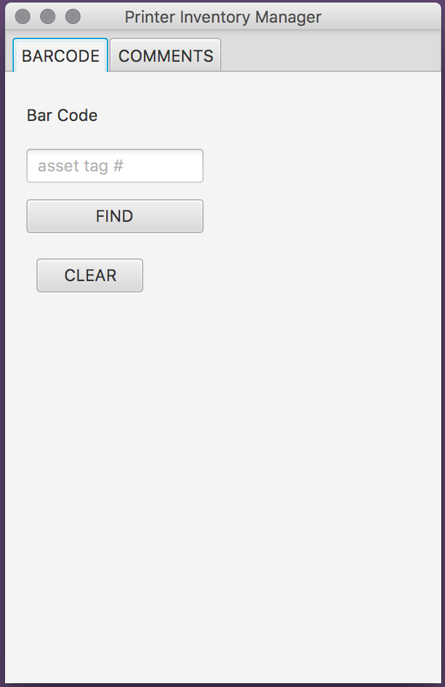
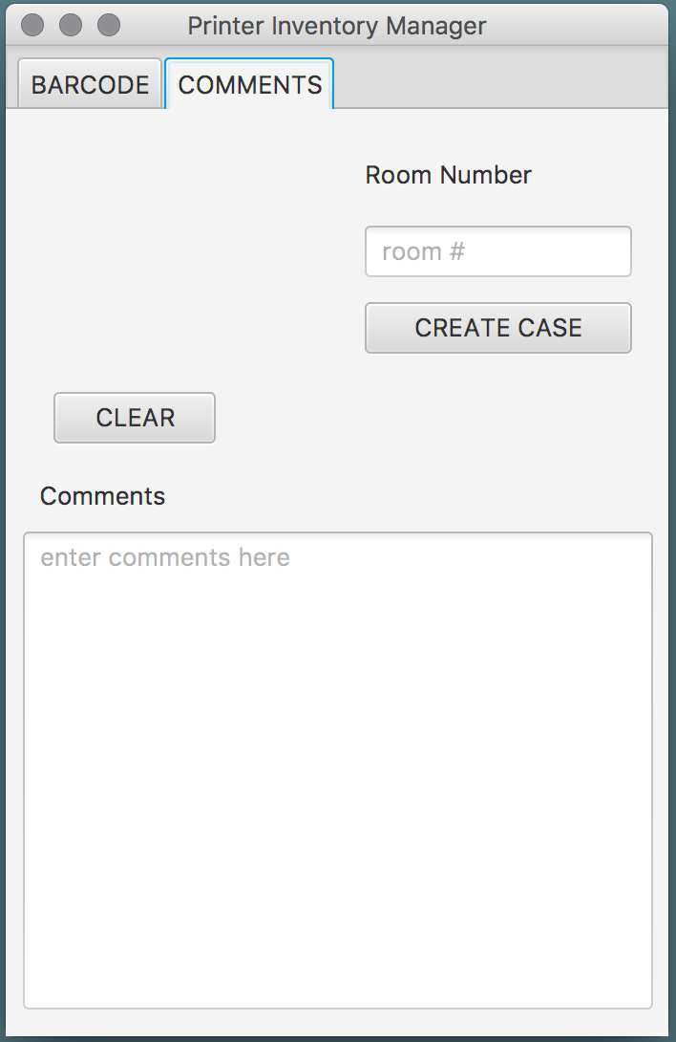
The user experience
The user runs the program and is presented with the following screen.

Slide 3
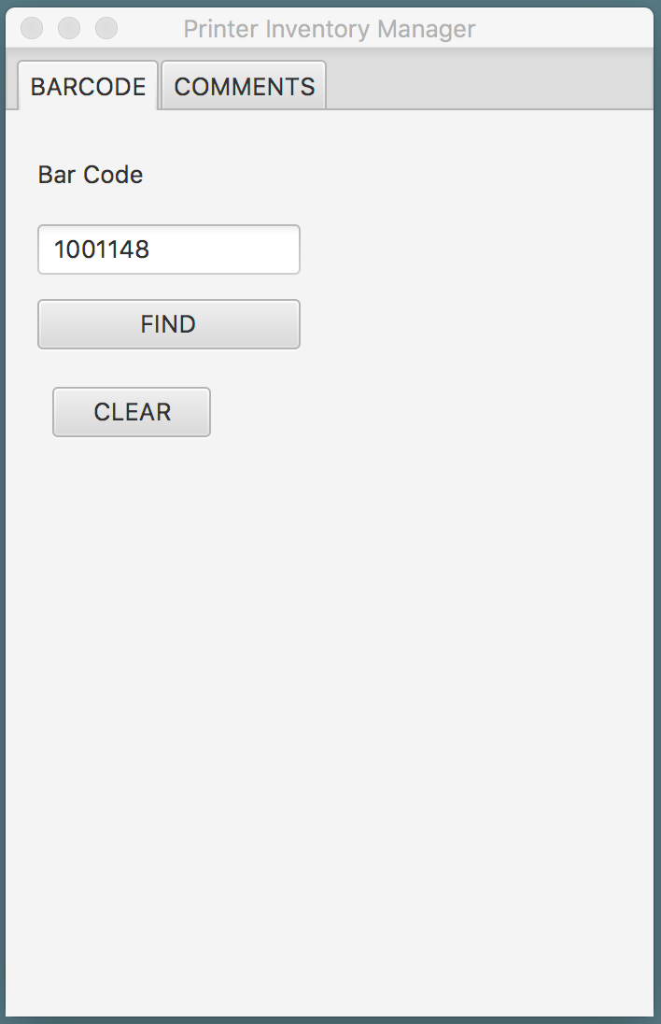
The user can then enter a barcode.

Slide 4
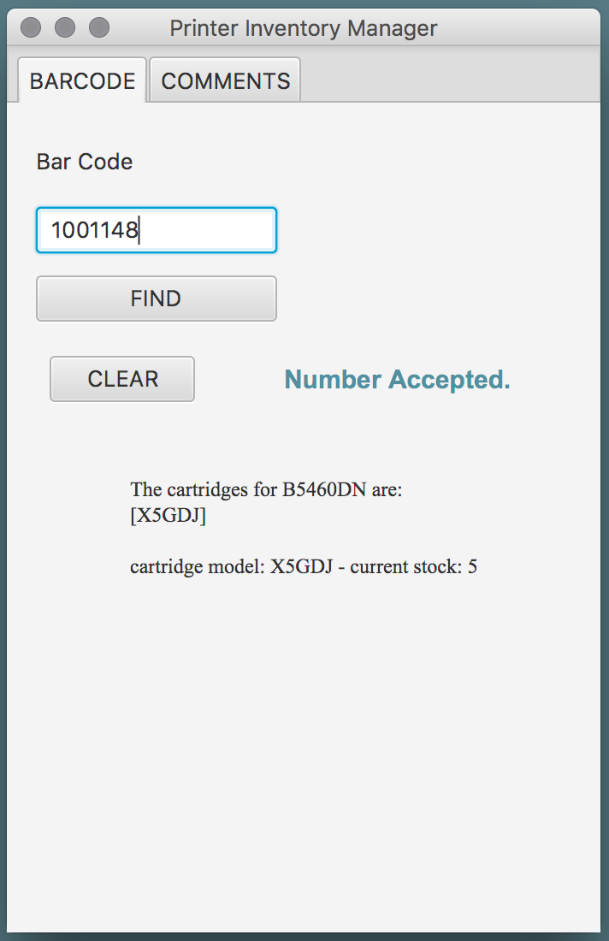
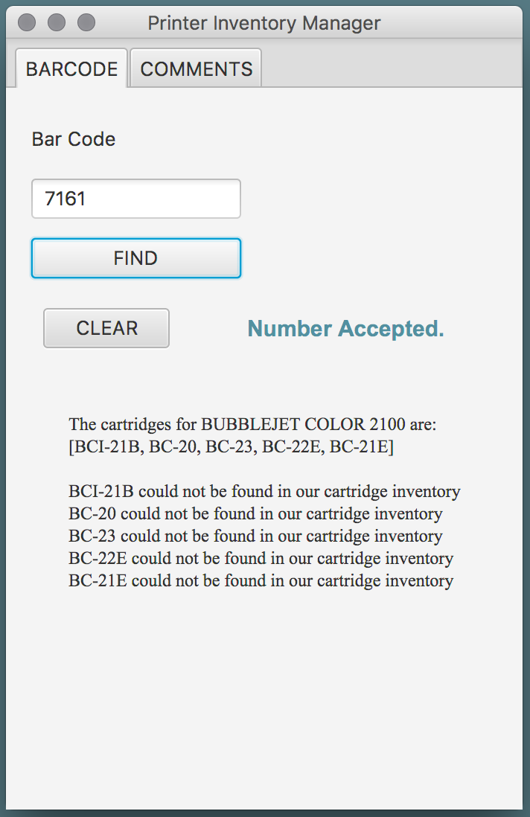
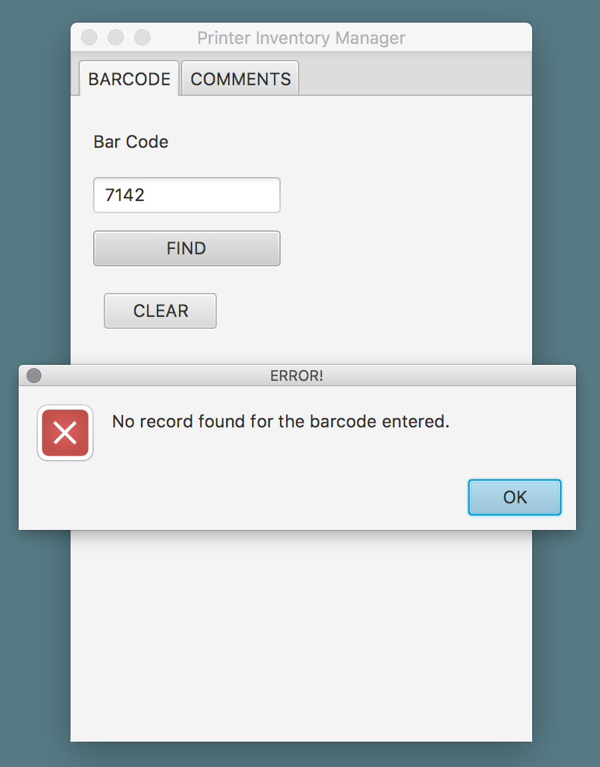
The results are as shown.

Slide 5
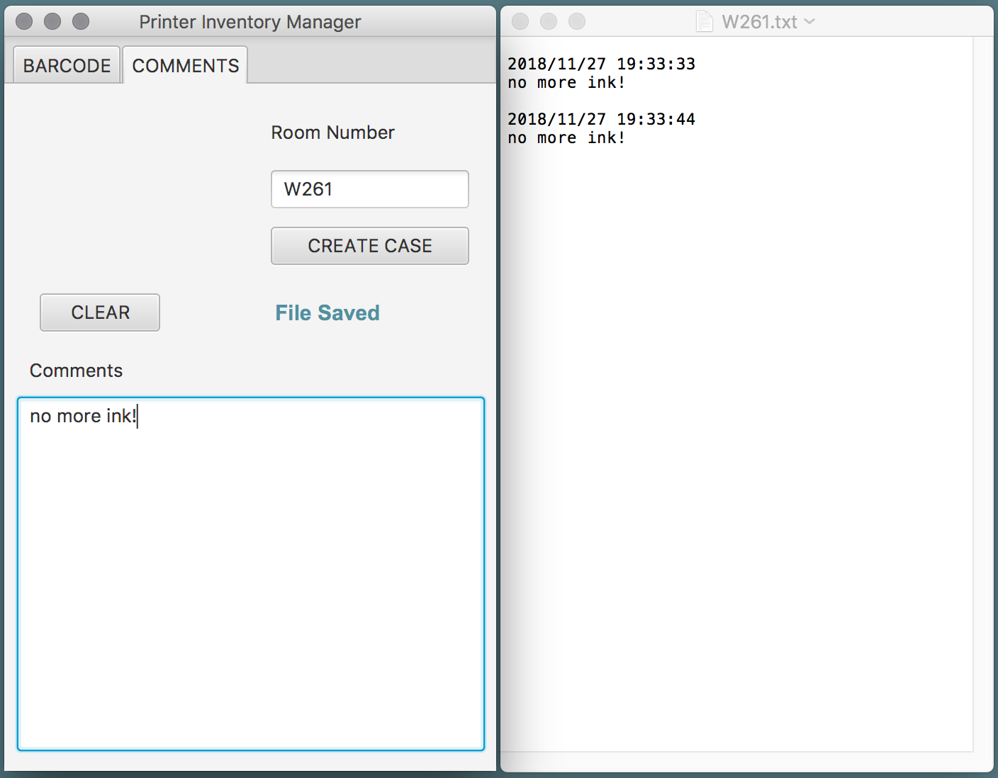
Comments may be entered, saving file to the room number.

Slide 6
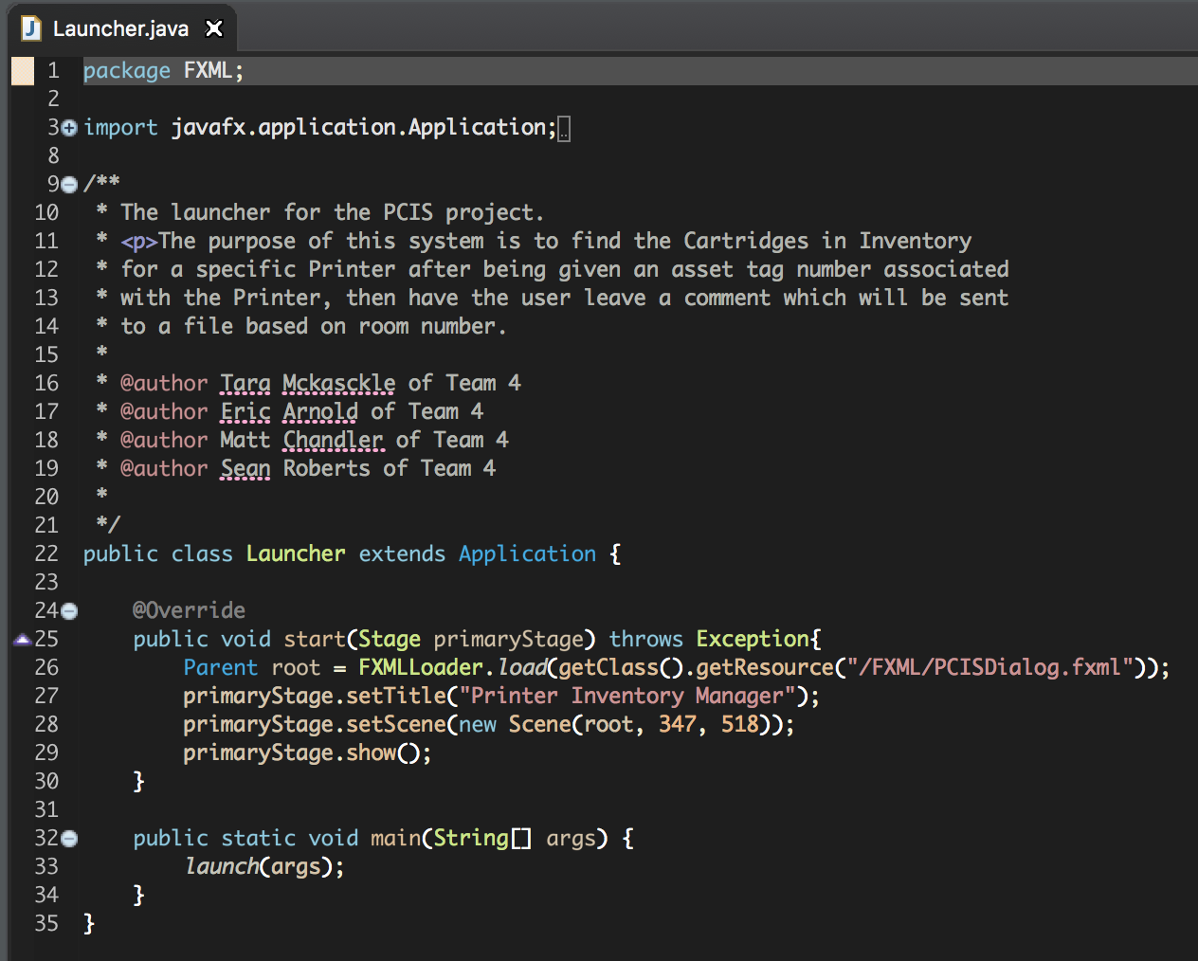
Source Code
Launching the application.

Slide 7
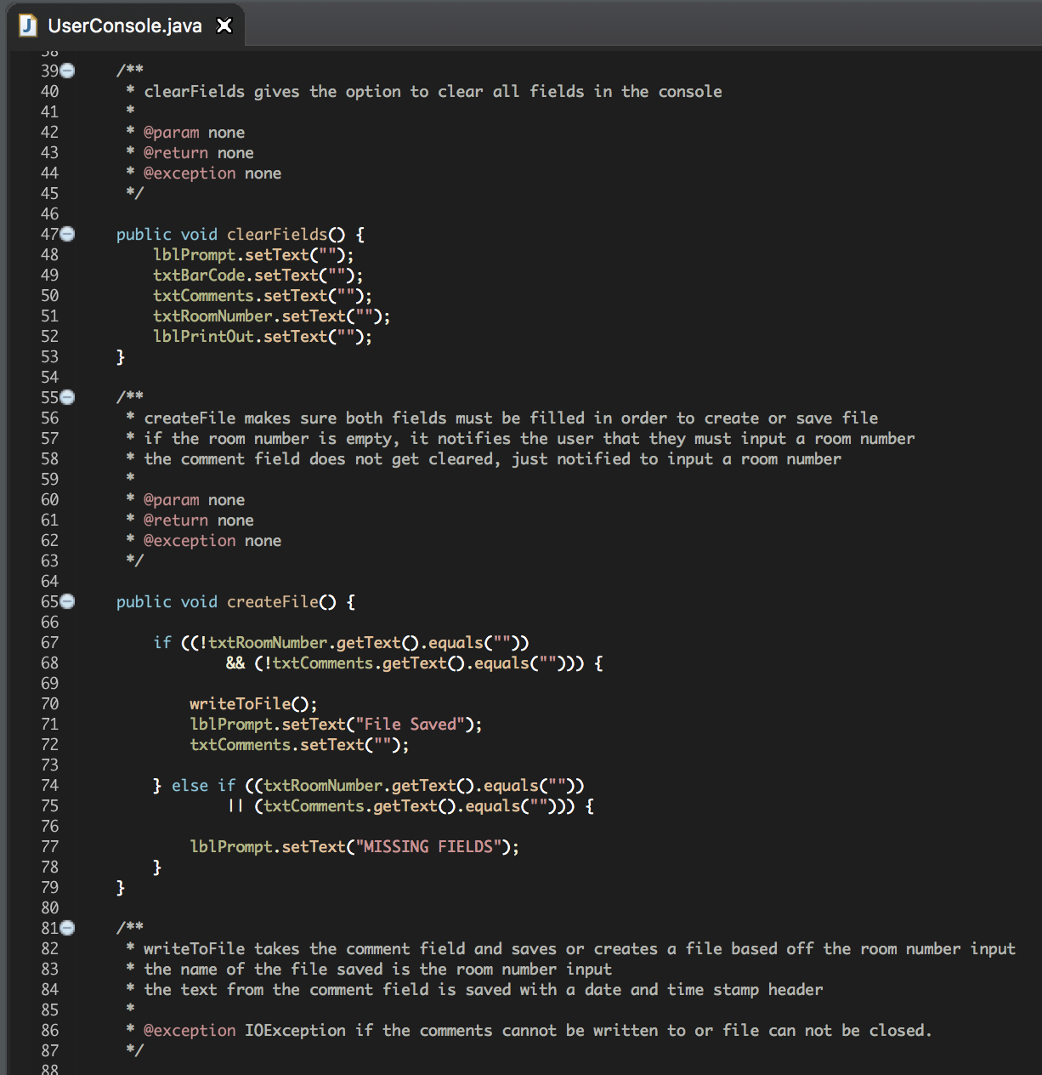

Source Code
The Console.
clearFields() method

Slide 8
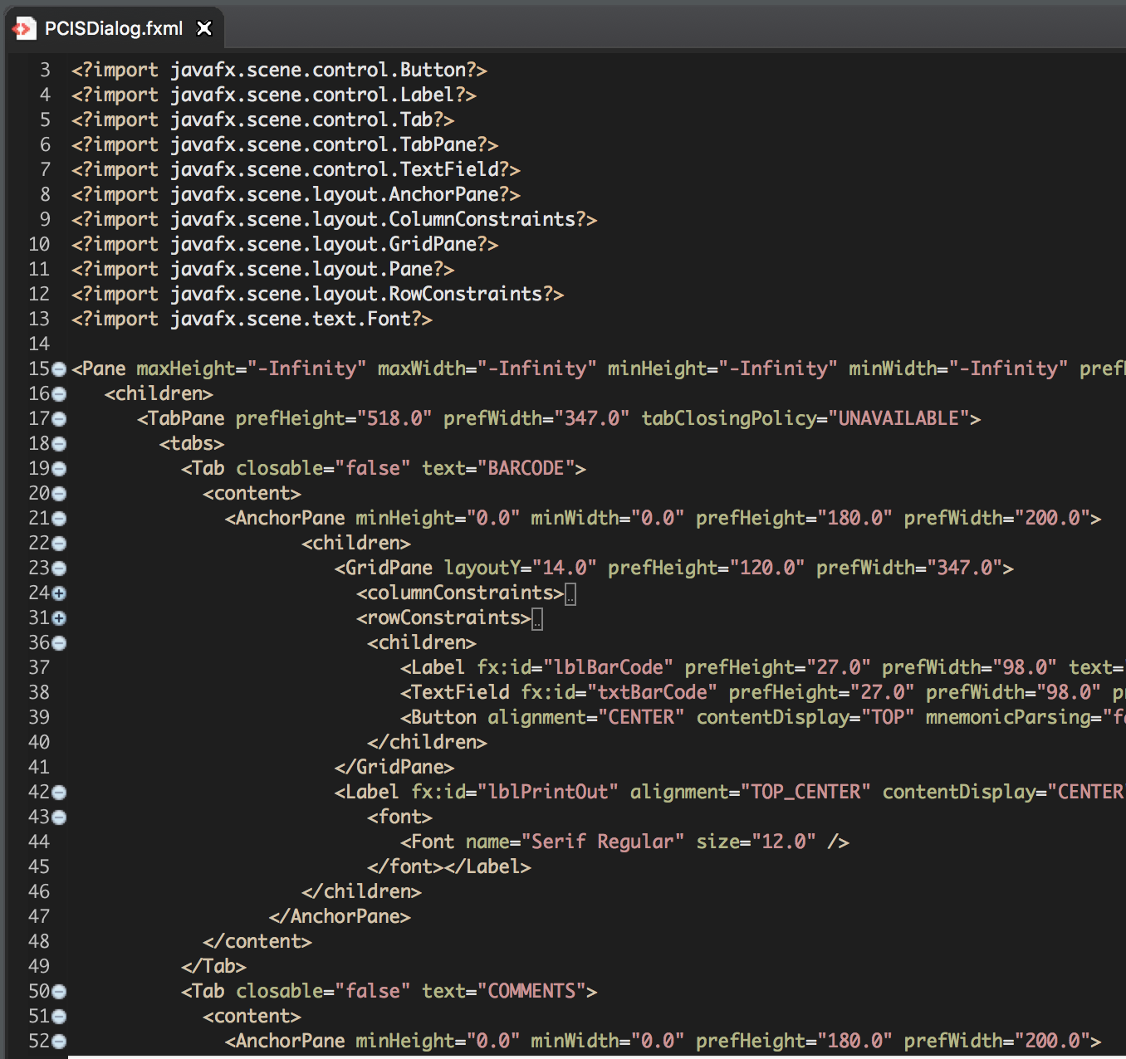
Source Code
Created with JavaFX.

Slide 9
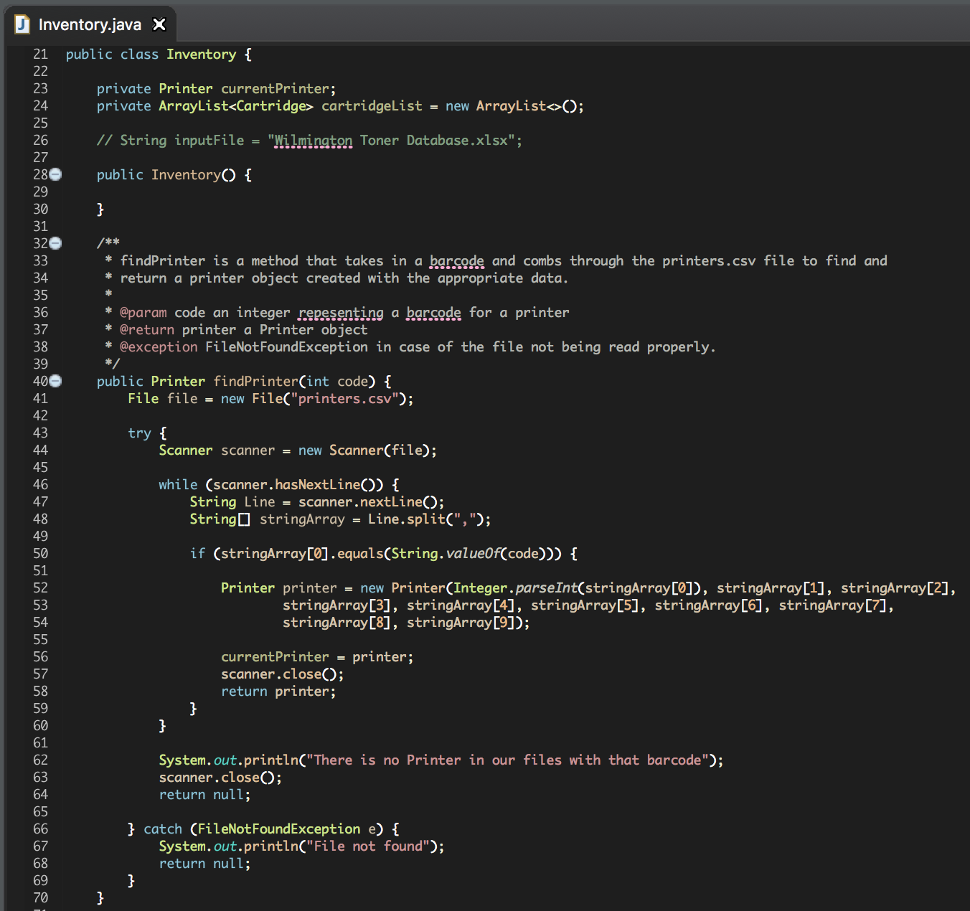
Source Code
The Inventory Class.
findPrinter() method

Slide 10
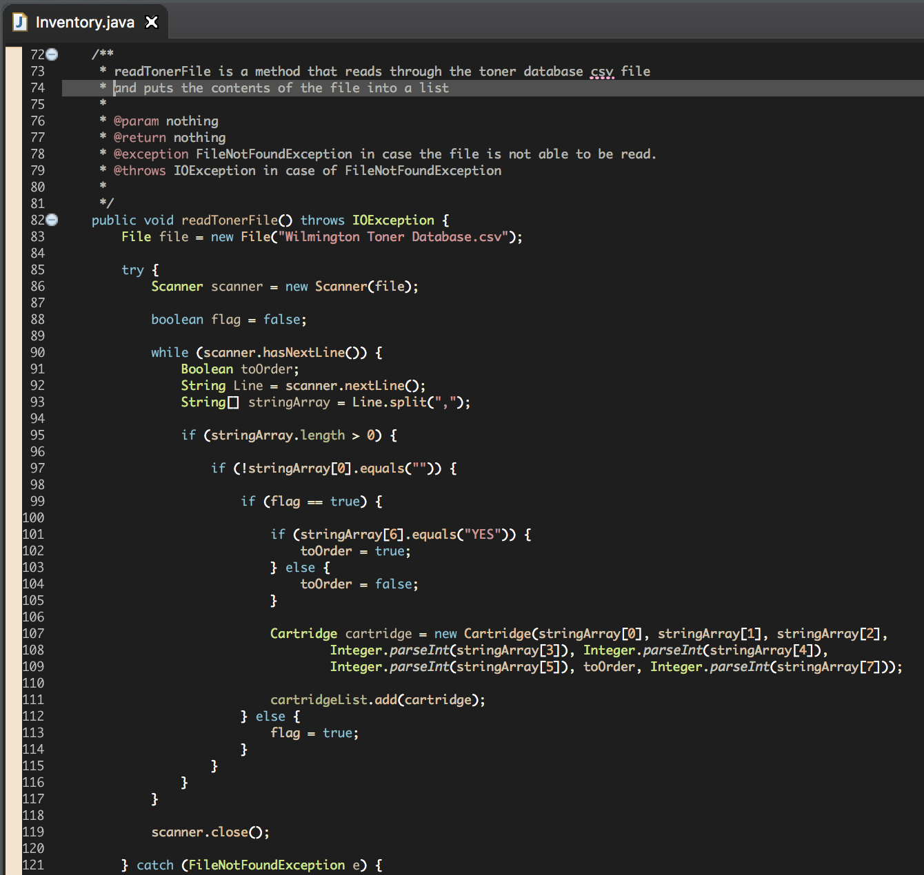
Source Code
readTonerFile() method
Inventory Class.

Slide 11
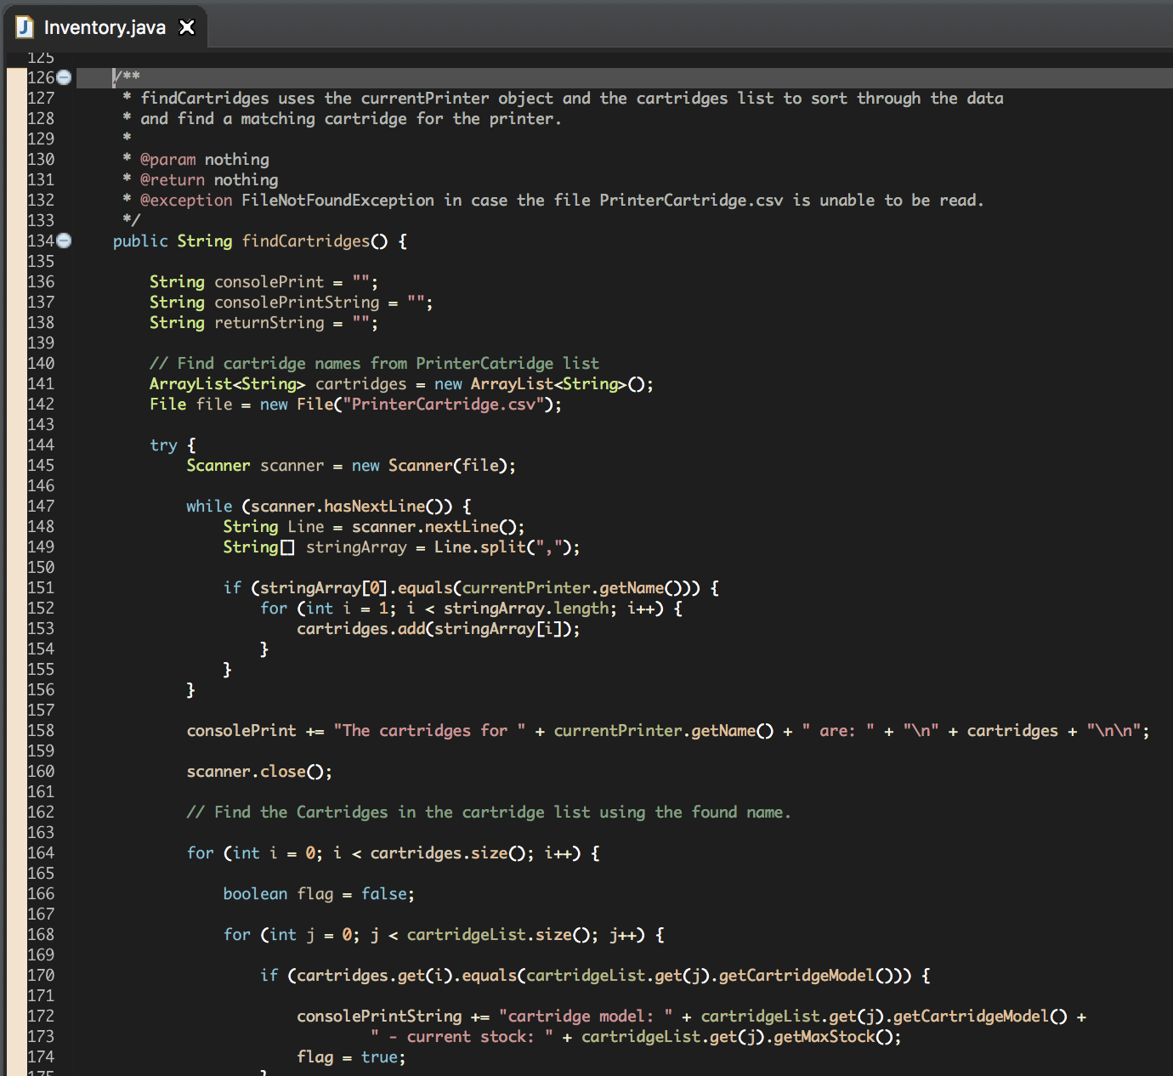
Source Code
findCartridges() method
Inventory Class.

Slide 12
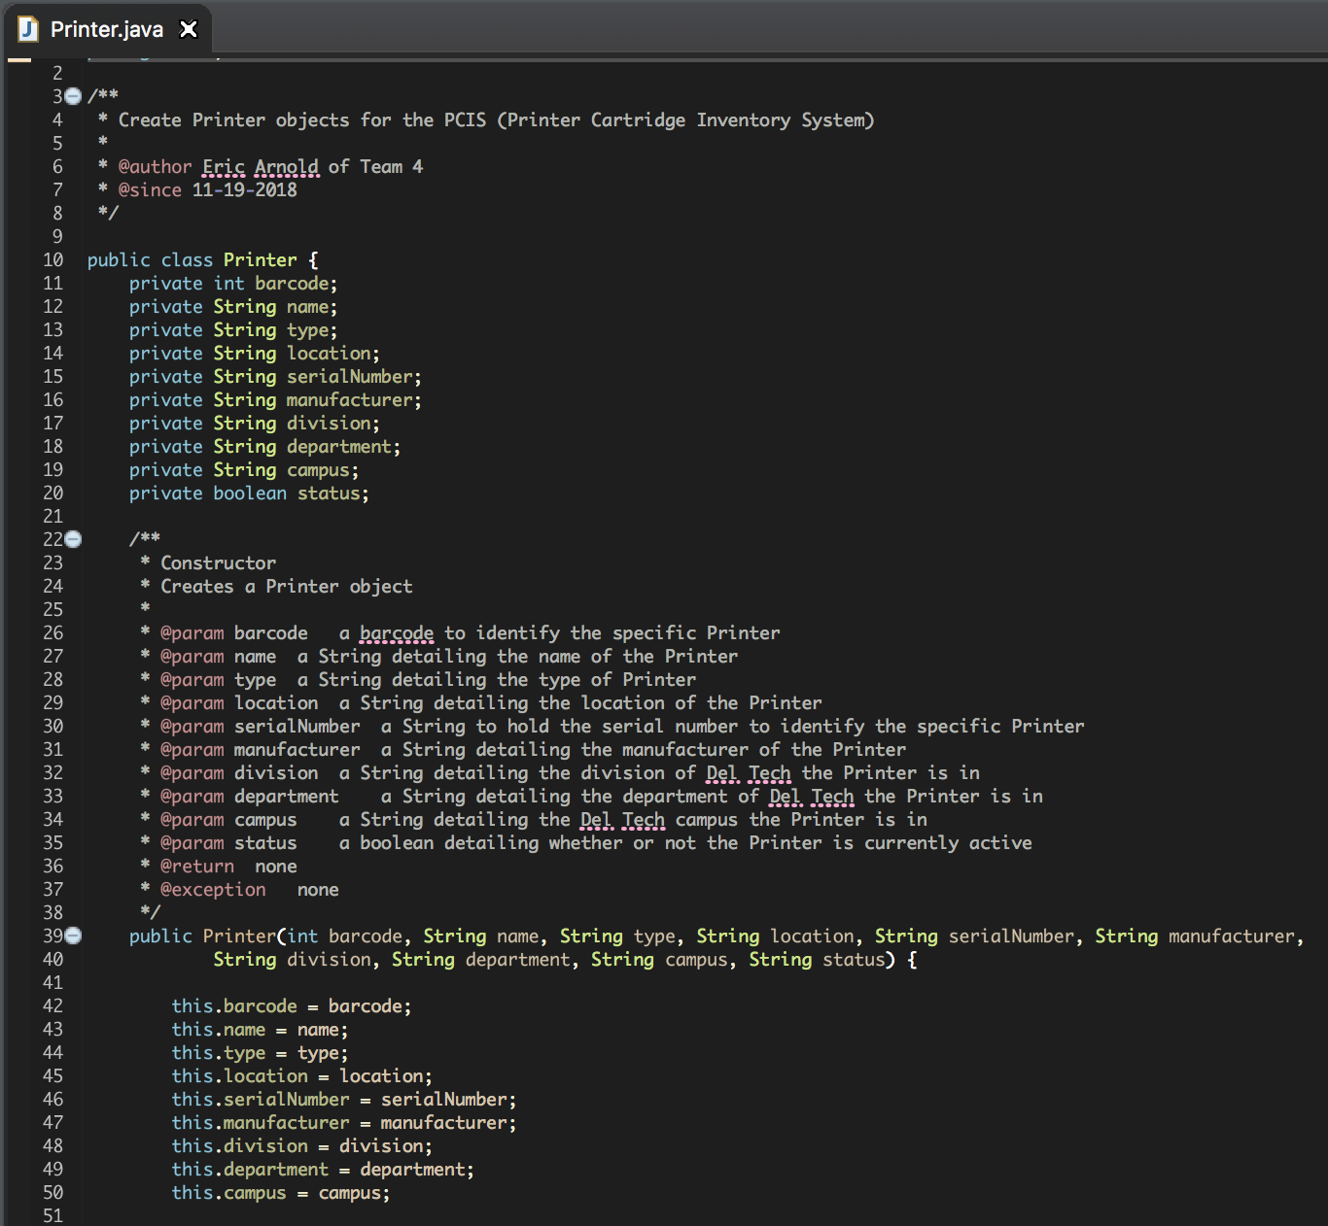
Source Code
The Printer Class.

Slide 13
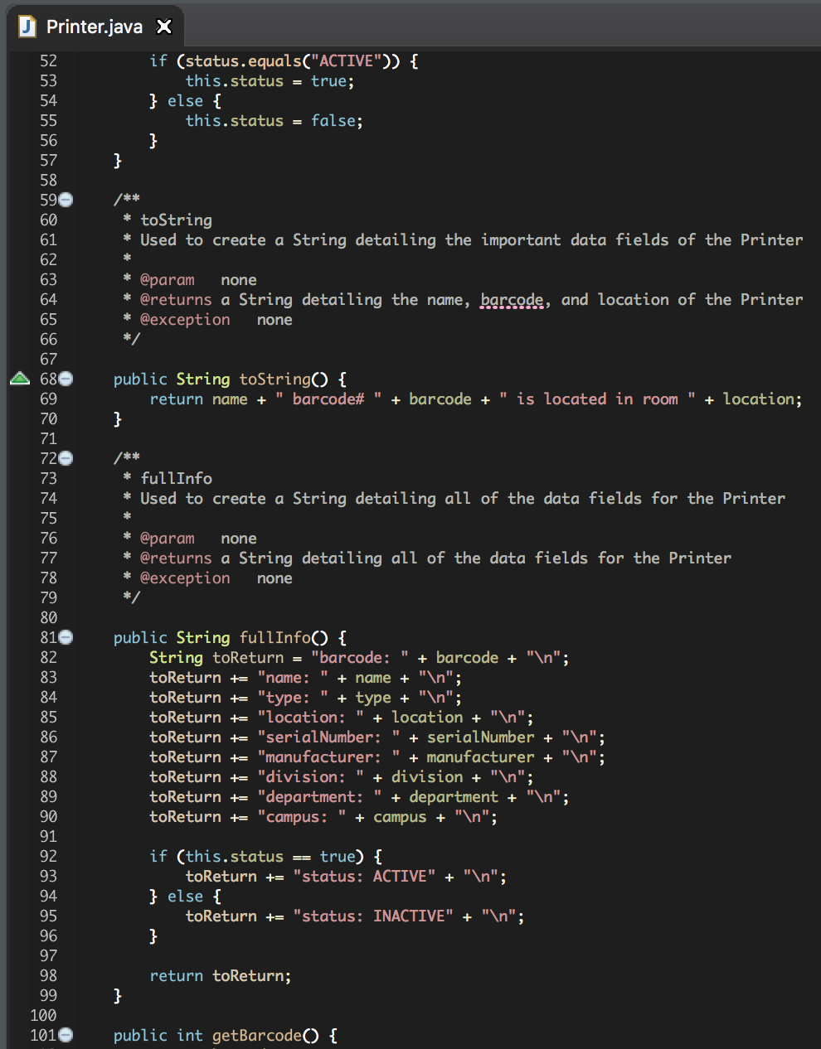
Source Code
Printer Class.

Slide 14
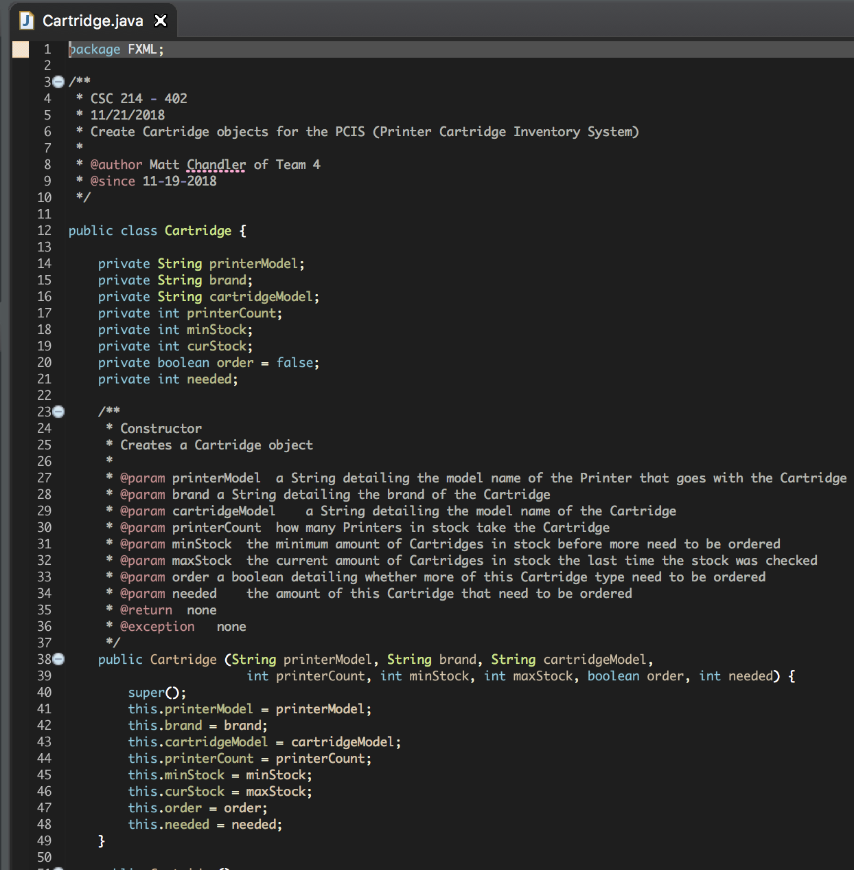
Source Code
The Cartridge Class.

Slide 15
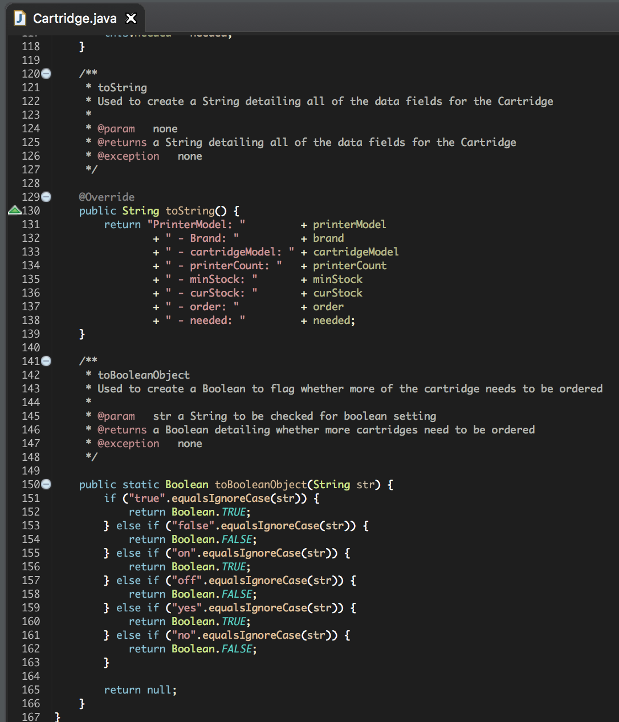
Source Code
Cartridge Class.

Slide 16
What our product provides...
Quickly checks the contents of your cartridge inventory
Prevents over or under ordering
Reduces technician and classroom downtime
Provides a better customer experience
Leave comments for the technicians to view
Informs technician of recurring problems
Provides information on cartridge use
Notes:
REDUCES COSTS!

Slide 17
Questions, comments, concerns?

Slide 18
REFLECTIONS
ERIC

Slide 19
REFLECTIONS
Overall thoughts about Software Engineering:
Challenge: interpretation to customer’s wants and needs
Coding Styles: very different, experienced during integration
UML Diagrams: preliminary ideas and logic changes
Documentation: SRS
TARA

Slide 20
REFLECTIONS
MATT

Slide 21
REFLECTIONS
-Learning to write code as a group
-Documentation
-Flexibility
Sean

